Slide 1

Ponder. Plan. Pitch.
With Renee Noble

Slide 2

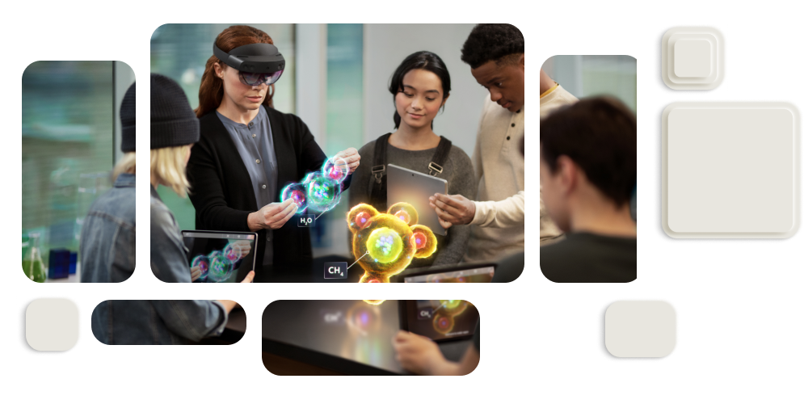
Build real tech to shape our world
Develop your skills
Create connections
Make a difference
Dream it. Build it. Live it.

Slide 3




What do we make?
Four categories where you can make your difference!
Healthcare
Environment
Education
Lifestyle

Slide 4



Previous projects
Melodic - Low cost speech therapy software/hardware solution for children with hearing impairments.
Nana Shilpa – Screening for and assisting kids with dyscalculia and dysgraphia.
V Bionic – help patients with hand paralysis recover 30% faster with adaptive rehabilitation and robotics.
Other Projects
Improve vision accessibility in games.
Identifying sounds sources to help people with impaired hearing.
Translate sign language into python code.
Learn sign language - get practice & feedback.
Manage agriculture businesses with AI

Slide 5
Brainstorm What are the broader issues we could address? (20 mins)
Let’s discuss the issues at hand in each of the 4 categories
Healthcare
Environment
Education
Lifestyle
We’ll vote for our highlight issues at the end

Slide 6
Where to next? We’ve got problems… How do we address them?

Slide 7
Where to next? We’ve got problems… How do we address them?
Understanding Stake holders
Understand needs and goals
Appreciate their difficulties
Create solutions they can/will use
Understand the people before the tech

Slide 8





Design Thinking
Understand users, define problems, create ideas, build and iterate!
Ideate
Iterate
Empathise
Define
Prototype
Notes:
If you were to complete the whole design thinking process it would look like this - we recommend you do this when entering Imagine Cup!
With design thinking we seek to understand the life of our user, what they want to accomplish, and the difficulties they face with that.
From there we can define a problem, and then work on generating ideas to solve that problem.
Once you have a solid idea, you can take that and prototype it. Then a key step is testing it on your actual users and seeing what they think.
From there you iterate and follow this process again and again to work out how to improve your ability to help your user. Sometimes this means going with a whole different solution, and sometimes it’s just making a few changes.
A key tip is not to get too invested in the tech, but rather to be fully invested in the outcome of your user.

Slide 9


Design Thinking
Understand users, define problems, create ideas, build and iterate!
Ideate
Iterate
Empathise
Iterate
Define
Prototype
Prototype
Notes:
If you were to complete the whole design thinking process it would look like this - we recommend you do this when entering Imagine Cup!
With design thinking we seek to understand the life of our user, what they want to accomplish, and the difficulties they face with that.
From there we can define a problem, and then work on generating ideas to solve that problem.
Once you have a solid idea, you can take that and prototype it. Then a key step is testing it on your actual users and seeing what they think.
From there you iterate and follow this process again and again to work out how to improve your ability to help your user. Sometimes this means going with a whole different solution, and sometimes it’s just making a few changes.
A key tip is not to get too invested in the tech, but rather to be fully invested in the outcome of your user.

Slide 10
Design Thinking
Understand users, define problems, create ideas, build and iterate!
Ideate
Iterate
Empathise
Iterate
Define
Prototype
Prototype
Pitch!
Notes:
If you were to complete the whole design thinking process it would look like this - we recommend you do this when entering Imagine Cup!
With design thinking we seek to understand the life of our user, what they want to accomplish, and the difficulties they face with that.
From there we can define a problem, and then work on generating ideas to solve that problem.
Once you have a solid idea, you can take that and prototype it. Then a key step is testing it on your actual users and seeing what they think.
From there you iterate and follow this process again and again to work out how to improve your ability to help your user. Sometimes this means going with a whole different solution, and sometimes it’s just making a few changes.
A key tip is not to get too invested in the tech, but rather to be fully invested in the outcome of your user.

Slide 11
How to… empathy!
Asking questions is key!
WHO
WHAT
WHY
HOW

Slide 12
How to… empathy!
Asking questions is key!
WHO - Get specific about who you are talking about!
You can solve everyone’s problems at once!
Are the problems specific to a unique to a:
Demographic of people
Location
User of specific products

Slide 13
How to… empathy!
Asking questions is key!
WHAT – Identify what their life looks like, what parts are hard.
Try and solve a specific part of their issues.
Consider:
Describe the users life
What tasks the user do in a day/week/month
Why is it difficult at the moment?

Slide 14
How to… empathy!
Asking questions is key!
WHY – Is there a reason things are challenging
Being specific about difficulties helps you get started.
What get’s in their way:
Are their physical difficulties
A lack of data/information
Are their systemic barriers that slow them down.

Slide 15
How to… empathy!
Asking questions is key!
How – Can we remove the barriers or work around them?
Come at it from the problem side, not solution first. What do they need?
What do they need access to?
People?
Expertise?
Resources?
Automation?

Slide 16
Team Time! We’ll work in groups to go deeper!
Choose your mission!
Off the topics we have chosen, nominate one that you want to join the discussion for

Slide 17
Team Time! We’ll work in groups to go deeper! (15 mins)
Choose your mission!
Of the topics we have chosen, nominate one that you want to join the brainstorm for
For your topic…
Who are specific stakeholders
What are their tasks/challenges
Why are there challenges
How could their life be easier? (no tech)
Use the PowerPoint Slides to brainstorm!
Pick 1 or 2 focus difficulties to present on

Slide 18
Let’s hear those ideas!

Slide 19
So… how do build a solution?
To enter Imagine Cup you need to include Azure.

Slide 20
Azure is… A Cloud Computing Platform
What does that mean?
Host sites, host data
Use cool APIs & avoid reinventing the wheel
Integrate IoT/Hardware with the cloud
Making it easier to make something “go live”

Slide 21
Essential Cloud Tech
“The must haves” of a Cloud Compute Platform
Deploy a web server
Host Static Websites
Keep a database
Store files
Manage DevOps and scaling

Slide 22
Make Tech Easy with APIs
Azure Cognitive Services
We built the tech so you don’t have to
Do translation, machine vision, audio processing, and more.
Easy to incorporate into any piece of software through API calls.

Slide 23
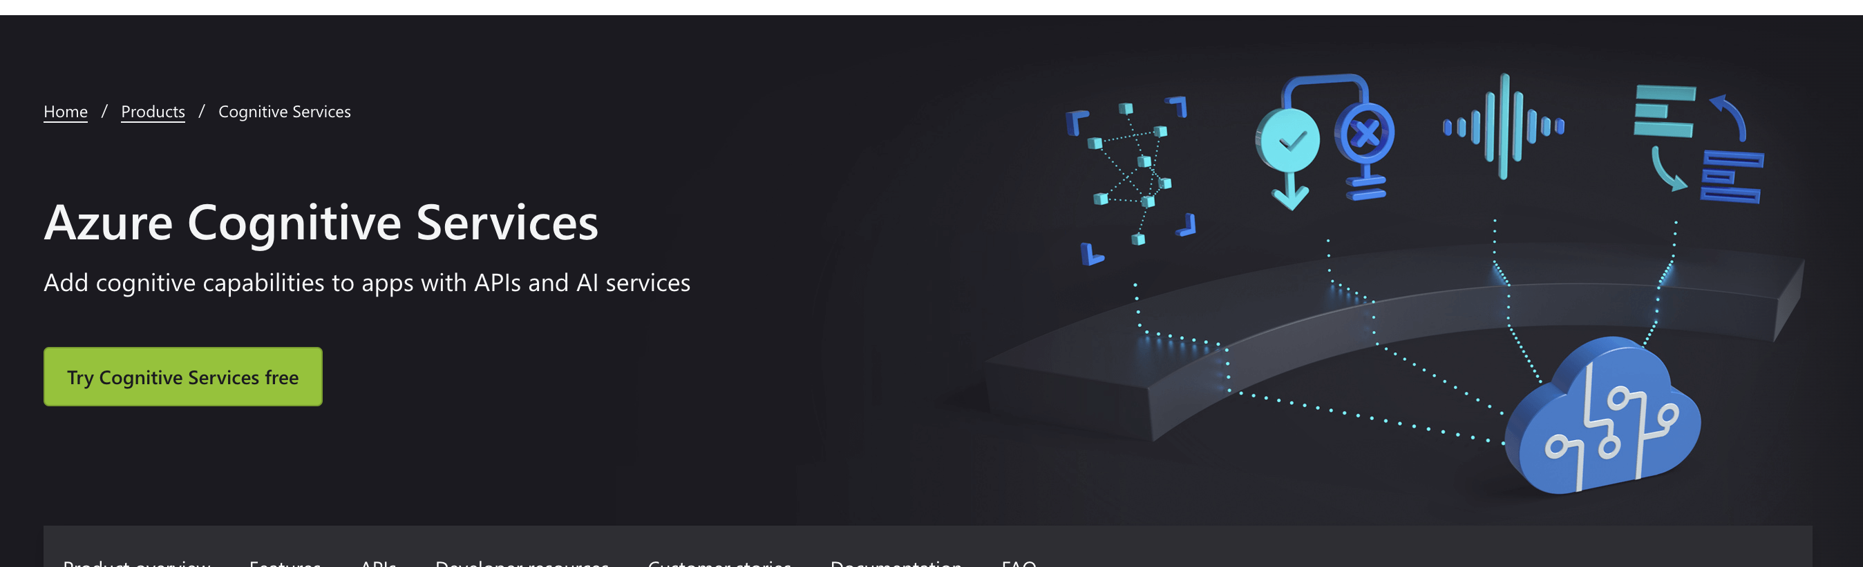
Loads more info on the Cognitive Services Page
https://azure.microsoft.com/en-us/products/cognitive-services/#overview

Slide 24
Touch the Tech with IoT
IoT Central
Put tangible tech in people’s hands
Collect real data in real time
Link that data to the cloud, use cloud compute to crunch the numbers
Or use edge devices to keep it localised/fast

Slide 25

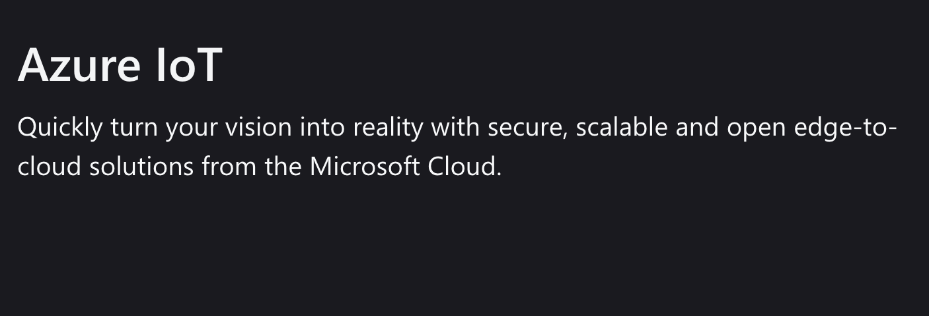
Loads more info on the Azure IoT Page
https://azure.microsoft.com/en-us/products/cognitive-services/#overview

Slide 26
What was all that again
Here’s a reference guide with some ideas

Slide 27
Team Time! Let’s look at solutions (15 mins)
Bring your problem to the tech.
Brainstorm how technology could be part of the solution to the key issues your identified. Consider hosting, utilising Azure APIs, IoT, and more.
Make sure your focus is the user!

Slide 28
Pitch it at me!
Why pitch?
Why do we pitch?
Communicate vision
Show we have a plan
Get buy in
Get people involved
We don’t just do it for comps, we do it all the time!

Slide 29
Pitch it at me!
The art of pitching
Telling a story
People who are we helping, what is their problem?
Making a difference How are we helping, is this a new way to do it?
Vision & Growth
How does technology let us do this?
Take your audience on a journey they get attached to.

Slide 30
Team Time Build you pitch! (10 mins)
Make a 1-2 minute pitch
Include answers to the 3 questions (people, difference, tech vision)
Plan it and practice it together Get ready to pitch to the audience!
Get ready to here pitches and provide support!

Slide 31
It’s Pitch Time!
Listen, and say 1 thing you liked and 1 bit of supportive feedback

Slide 32
What next?
Get the resources from this session on GitHub
Sign up for Imagine Cup
Get Imagine Cup resources Learn more about Azure on Microsoft Learn
Join IC Discord – find teammates, ask questions

